Slide 1
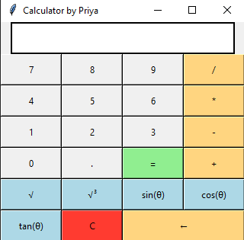

GUI CALCULATOR PROJECT 01
By: Priya Tirpathi

Slide 2
INTRODUCTION
The primary goal of this project is to create a fully functional calculator using Python's Tkinter library, capable of performing both basic arithmetic and advanced mathematical operations. The calculator also demonstrates the versatility of Tkinter for creating graphical user interfaces.

Slide 3
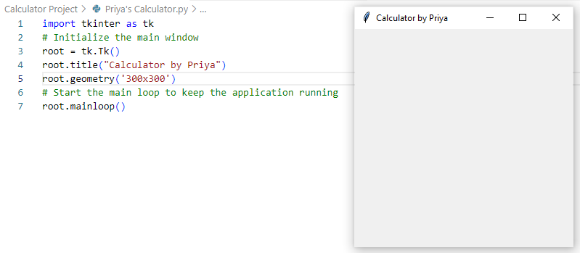
INTRODUCTION
A Tkinter-based Calculator with Advanced Features:
Importing the ‘tkinter’ library in VSC
Initialize the main window.
Giving a title to the main window.
Setting the size of the window using.
Starting the main loop to keep the application running.

Slide 4
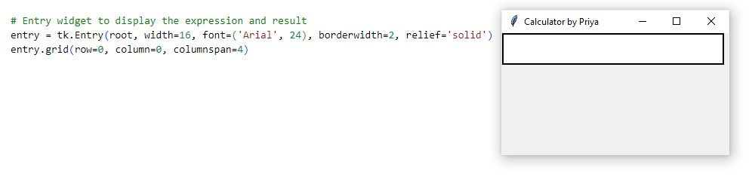
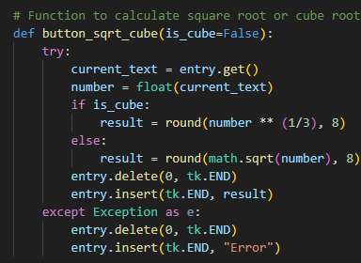
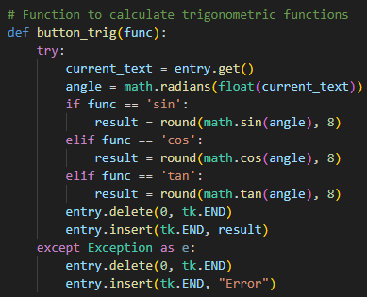
INTRODUCTION
Creating Entry Field for Display Text:
Trigonometric Functions and Square/Cube roots:

Slide 5
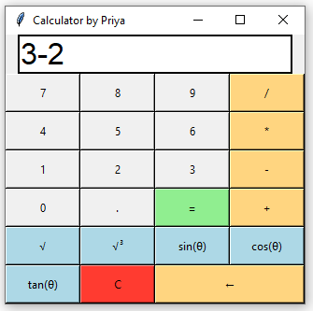
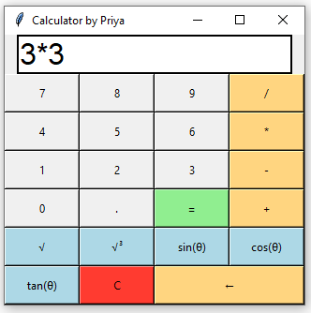
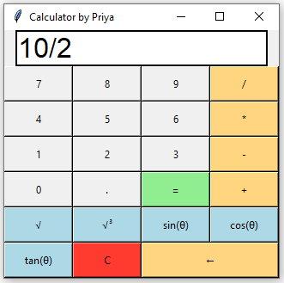
Features
Calculator Features:
Perform basic operations: addition, subtraction, multiplication, and division.
Calculate square root and cube root.
Perform trigonometric functions such as sin, cos, and tan.

Slide 6
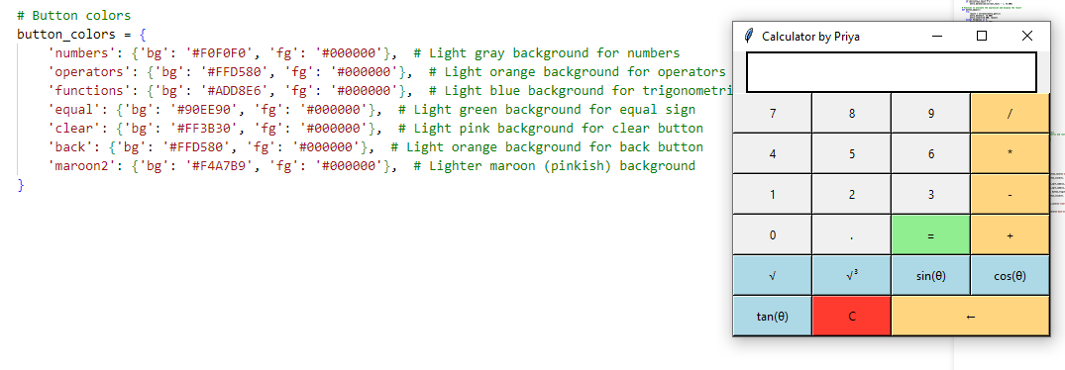
Design and Layout
Grid layout for positioning buttons.
An entry widget is used to input and display expressions and results.
Buttons are color-coded for numbers, operators, and functions.
GUI designed using Tkinter, a built-in Python library.

Slide 7
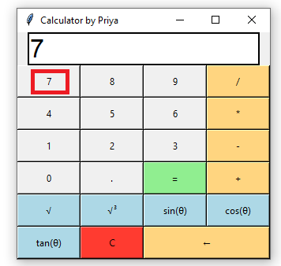
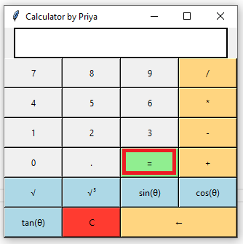
Functions in Code
Button_click(): Appends clicked numbers and operators to the display.
Display.button_equal(): Evaluates the expression in the display and shows the result.

Slide 8
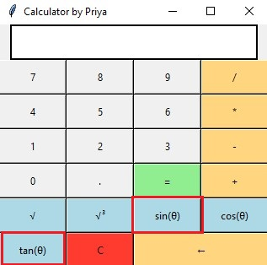
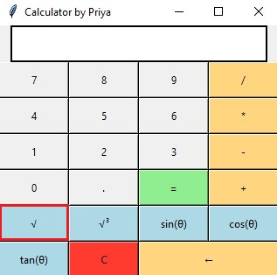
Functions in Code
Button_trig(): Handles trigonometric calculations after converting input to radians.
Button_sqrt_cube(): Calculates the square root or cube root based on user input.

Slide 9
Trigonometric Functions
Trigonometric functions are implemented using Python's math module.
The calculator can compute sine, cosine, and tangent for angles in degrees.
Angles are first converted to radians before calculation.

Slide 10
Conclusion
This project is a well-crafted Python calculator using tkinter, handling basic arithmetic and advanced functions like square roots, cube roots, and trigonometry. The user interface is intuitive, with clear button layouts and color distinctions. The code is modular, improving readability and maintainability.
KEY POINTS:
Functional Coverage: Basic arithmetic and advanced math functions.
User Interface: Simple, organized, with effective error handling.
Enhancements: Consider adding more scientific functions, improving UI design, and using safer evaluation methods than eval().
This project is a solid foundation for learning Python GUI development and can be expanded with additional features and improved design.

